Slide 1

Parking Garage
By Mariam Khan, Ali Vali, Garrett Snyder, Hadyn Minnigh

Slide 2

Our Purpose
We are a small parking garage business, who's main goal is to provide a streamlined, safe service for our customers. Our security and valet aim to provide an easy and convenient experience, prioritizing customer satisfaction.

Slide 3
Business Rules Prototype
Starting out, we had five major entities: Parking Space, Customer, Transaction, Payment, and Employee.
Parking Space Rules: Space = Unique SpaceID. A space is in 1 of 3 states: Available, Occupied, Reserved
Customer Rules: Customer = Unique CustomerID. Contact and car information required.
Transaction Rules: Transaction = Unique TransactionID. At each interaction, time is recorded to calculate the cost of parking at a predetermined rate.
Payment Rules: Payment = Unique PaymentID. Payments are associated w/ a Transaction.
Employee Rules: Employee = Unique EmployeeID. Hourly wage is calculated via rate * hoursworked.

Slide 4
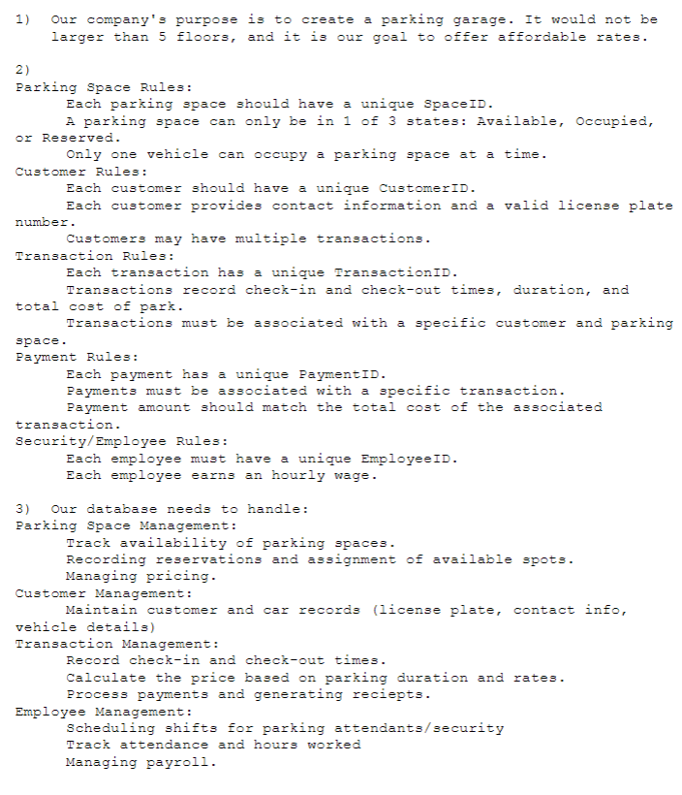
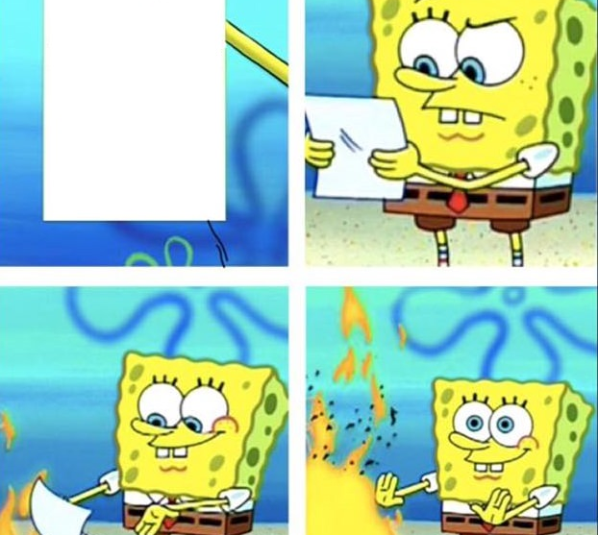
Deconstructing Initial Business Plan Failures
Redundancy: There is no need for a separate 'Payment' table with the 'Transaction' table.
Types of Employees: We wanted to launch a valet service, as well as provide security, which isn’t included.
Loyalty Plan: A loyalty plan would incentivize repeat customers, which is not included.
HR Dept: There was no payroll or management in the initial plan, necessitating an HR department.

Slide 5

The Finalized Business Plan + Rules
Removal of Entity 'Payment'
Inclusion of various super and subtypes: Employee and Customer tables
Adding an HR department
New Loyalty Plan
Many basic business rules still apply!
Here are the new ones:
Employees may be designated as managers and must have a corresponding ManagerID.
Employees must belong to a specific department within the HR system.
Valets = Unique ValetID. Must have a DL number.
Security = Unique SecurityID. Monitors specific areas within the garage.
Repeat customers may choose to sign up for the loyalty plan, resulting in a unique MembershipID and the recording of the membership billing date and rate.

Slide 6
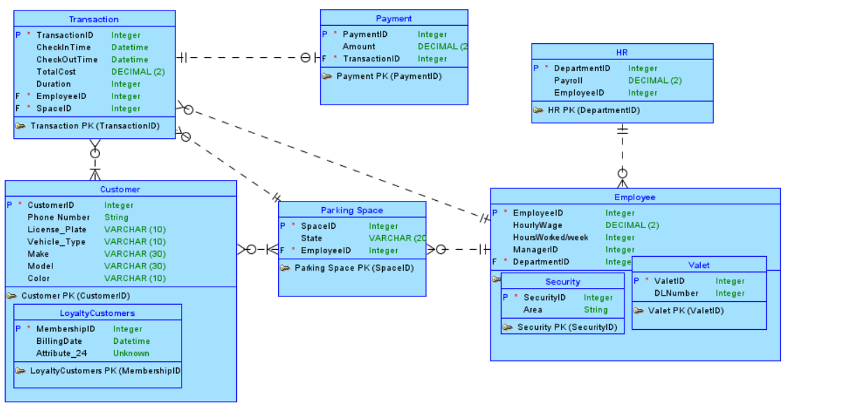
Part 2: EER

Slide 7
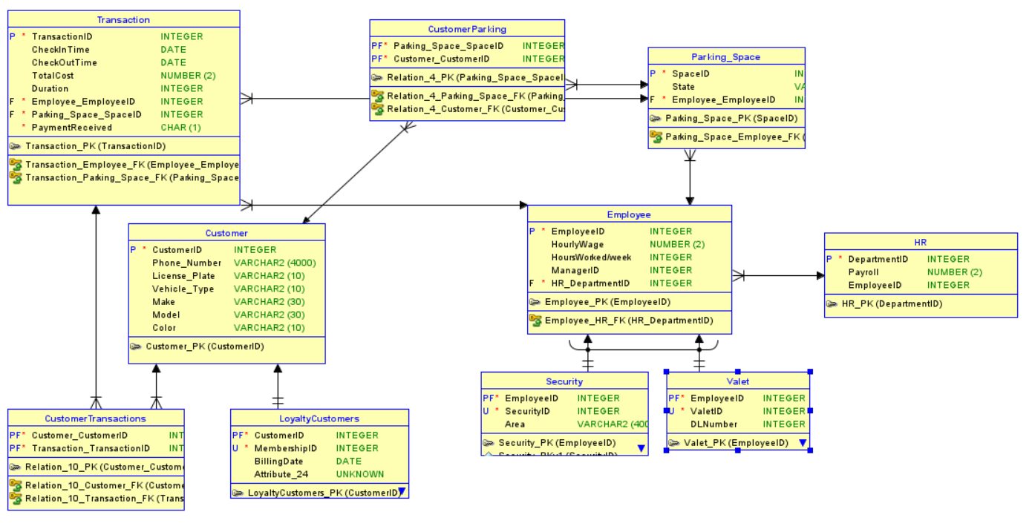
Part 2.5 EER Relational

Slide 8
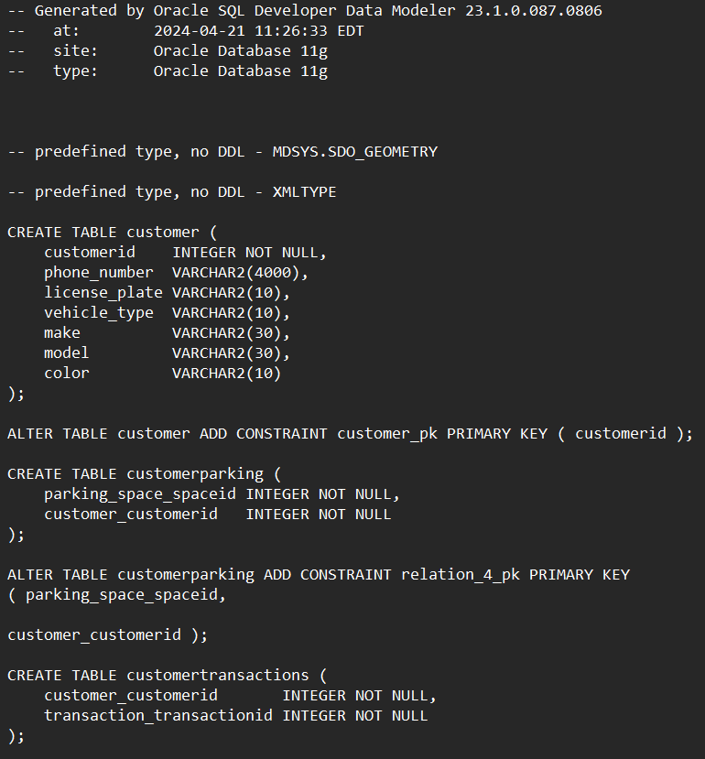
Part 3: Relational
- from the relational model, ddl commands were generated.
-snippet of ddl file ->
OG Schema.docx

Slide 9
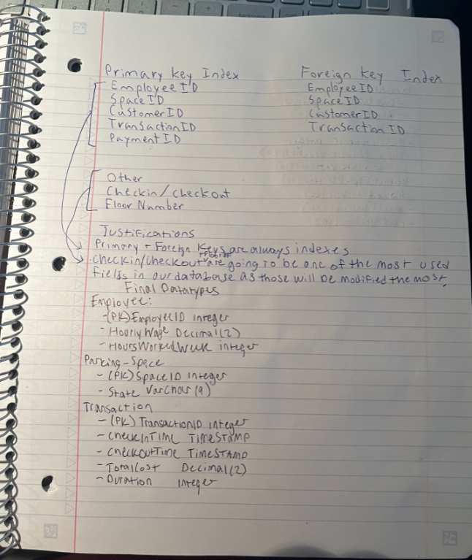
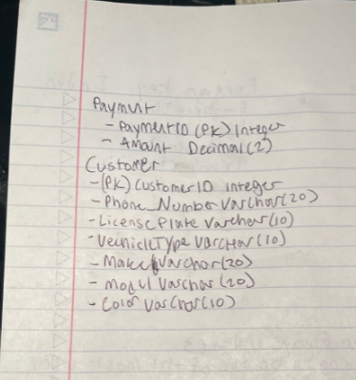
Part 4: Physical Design
When we created our physical design we iterated through each value in every table to find the primary keys first.
Afterwards we again went through and identified the foreign keys.
We decided the datatypes based off of what we envisioned the database looking like as if it was already implemented and working full time

Slide 10
Part 5: DBA
We decided to implement incremental backups, rollback recovery, deferred update protocol, and data control language
The decision was based upon wanting a robust database security strategy that would be fool proof
Incremental backups reduce storage needs
Rollback recovery guarantees a safe state to return to
Deferred update protocol avoids unnecessary writes
DCL protects data from unauthorized access

Slide 11
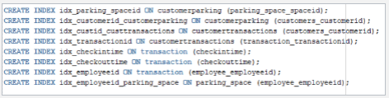
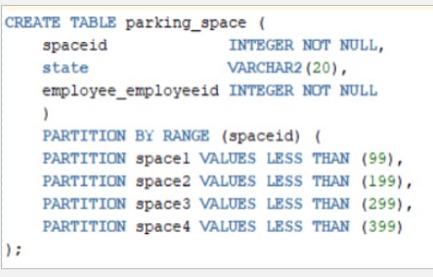
Part 6: Implementation
We created supertypes of Valet & Security in the Employees table
We created the supertypes of Loyalty customers in the Customer table
We decided to index Employee ID, space ID, Customer ID, Transaction ID, & Payment ID as our main keys
Our foreign key index consisted of Employee ID, Space ID, Customer ID, & Transaction ID
We also indexed Check in & checkout as well as Floor Number

Slide 12
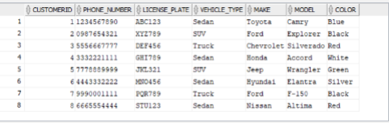
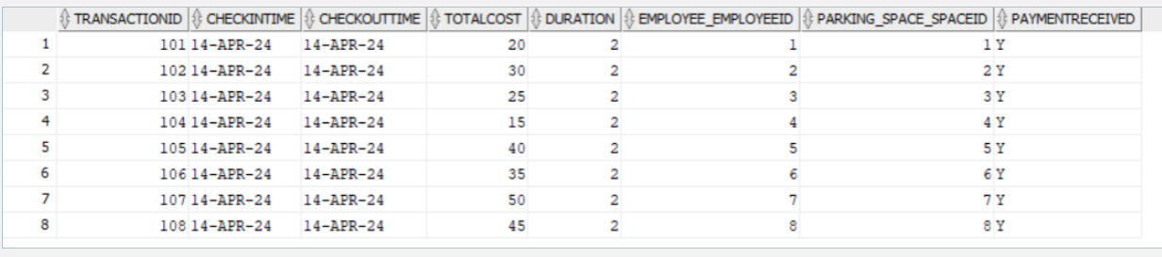
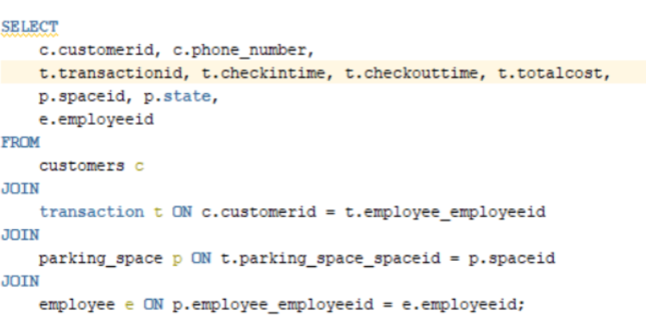
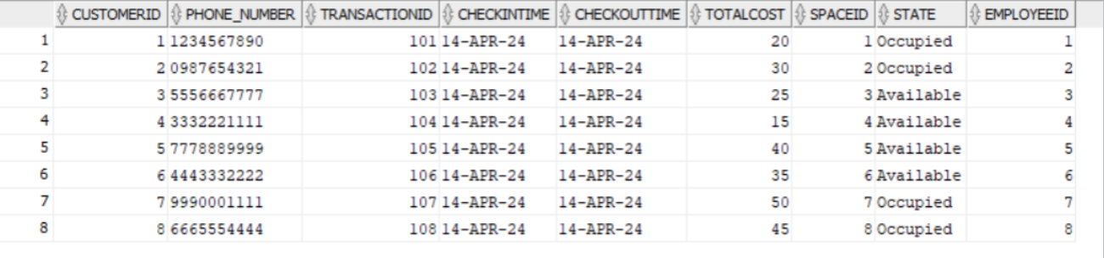
Part 7: Data
We came up with a variety of sample data for every table
Had multiple entries per table and of every field
Including supertypes of Valet, Security, & Loyalty Customer
We partitioned floors so we can more easily digest data based on lower floors vs higher floors

Slide 13

Pitfalls
During the project we came across some pitfalls and troubles
When we went to save the database Oracle was down so we couldn't
We were hesitant on whether or not we should add more to our database
Our initial business plan was not encompassing all aspects of our project

Slide 14

Success
We were able to change the database to include much more information and be overall better quality with consultation of the TA
Worked together very well and learned how to use databases in a commercial setting
Learned how to use SQL developer and oracle to a higher skill level
Covering all corners and thinking about things we usually wouldn't like backups and recovery

